Slide 1
Setting up a Payment Plan

Slide 2
Click on the link in the email you received when you booked your course or click on the Shopify icon below
Add the required courses to the cart
Click on the shopping bag icon to go to your cart
Click ‘check out’
Enter your details and then click ‘continue to payment’
Select and click on ‘complete order’

Slide 3
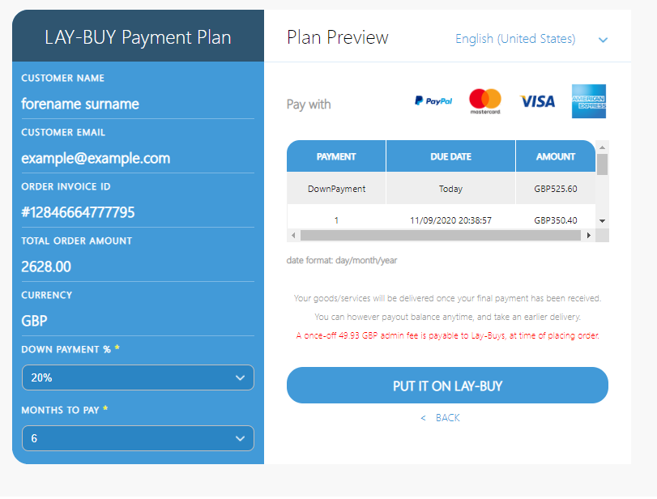
How your payments will be broken down
Your details
Choose deposit amount 20-50%
1.9% fee will be added
Choose number of monthly payments
Click here when you are happy with your payment plan

Slide 4
You will now be re-directed to PayPal where you pay the deposit and the instalments are set up. You can pay with your PayPal account or with a credit/debit card.
We will receive confirmation when you make payments, you do not need to notify us separately.

